Slide 1
Summary of: Time-varying formation control of a collaborative heterogeneous multi agent system
Written by: Reihane Rahimi, Farzaneh Abdollahi, Karo Naqshi
Presented by: Josh Blackham
Reihane Rahimi, Farzaneh Abdollahi, Karo Naqshi, Time-varying formation control of a collaborative heterogeneous multi agent system, Robotics and Autonomous Systems, Volume 62, Issue 12, 2014, Pages 1799-1805, ISSN 0921-8890, https://doi.org/10.1016/j.robot.2014.07.005.

Slide 2
Outline
Motivating Purpose
Background Literature
Summary of Objective
Model
Controller
Simulation
Obstacle Avoidance
Expanding Coverage

Slide 3
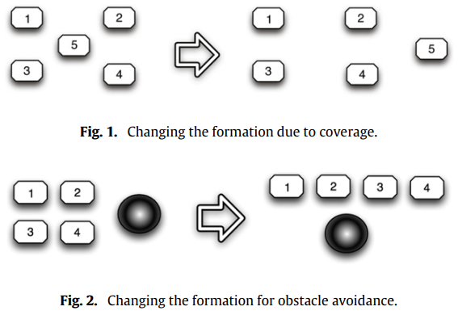
Motiving Purpose
Formation control in civilian environments, including rescue, surveillance (mapping) and discovery.
Increasing visibility of the formation by covering a greater part of the environment
Obstacle avoidance of specific agents affect the formation
Different agents (UAV and UGV) have different dynamics to control
Notes:
Figure 1: By allowing agent 5 to adjust to a new position in a new formation, the agents cover more area.
Figure 2: When agents come across an obstacle, individually they could break formation and move around the obstacle. A safer and more efficient way to avoid the obstacle can be changing to a different formation.

Slide 4
Relevant Background Literature
Leader-follower formation control
A. Brandao, M. Sarcinelli-Filho, R. Carellit, T. Bastos-Filho, Decentralized control of leader–follower formations of mobile robots with obstacle avoidance, in: IEEE International Conference on Mechatronics, Spain, 2009, pp. 1–6
M. Ji, A. Muhammad, M. Egerstedt, Leader-based multi-agent coordination: Controllability and optimal control, in: American Control Conference, USA, 2006, pp. 1358–1363.
H. Tanner, On the controllability of nearest neighbor interconnections, in: IEEE Conference on Decision a and Control, Atlantis, 2004, pp. 2467–2472
Virtual leader formation control
N. Leonard, E. Fiorelli, Virtual leaders, artificial potentials and coordinated control of groups, in: Proceedings of the IEEE Conference on Decision and Control, USA, 2001, pp. 2968–2973.
R. Olfati-Saber, Flocking for multi-agent dynamic systems: algorithms and theory, IEEE Trans. Automat. Control 51 (3) (2006) 401–420.
H. Su, Flocking of multi-agents with a virtual leader, IEEE Trans. Automat. Control 54 (2) (2009) 293–307.
R. Mead, R. Long, J. Weinberg, Fault-tolerant formations of mobile robots, in: Proceeding of the IEEE/RSJ International Conference on Intelligent Robots and Systems, USA, 2009, pp. 4805–4810.
X. Yung, Formation control for multiple autonomous agents based on virtual leader structure, in: Proceedings of Chinese Control and Decision Conference, China, 2012, pp. 2833–2837.
Notes:
What are the papers most related to this work? <this could include papers that were published after this paper>
What contribution did these authors make that went beyond any prior research?
Leader-follower formation control
Leader gets no feedback and can be instable. If leader fails, everything collapses
Virtual leader
Leader never fails, and stability of system is not dependent on the leader.

Slide 5
Relevant Background Literature
Collaborative Control
Virtual leader UAV guides UGV around obstacles
A. Aghaeeyan, F. Abdollahi, H.A. Talebi, UAV guidance for tracking control of ugvs in presence of obstacles, in: Proceeding of the RSI/ISM International Conference on Robotics and Mechatronics, Iran, 2013, pp. 135–140.
Rigid 3D formation with velocity constraints and obstacles
R. Rahimi, F. Abdollahi, Optimal formation of a collaborative maneuver with inequality constraints, in: Proceeding of the RSI/ISM International Conference on Robotics and Mechatronics, Iran, 2013, pp. 462–467.
R. Rahimi, F. Abdollahi, Synchronized coherent swarming of a collaborative multi agent system in presence of disturbance, in: Proceeding of the 21th Iranian Conference on Electrical Engineering, Iran, 2013 (in press).
This Paper
Considers rigid formation with both UGVs and UAVs (heterogenous) while proposing solution for obstacle avoidance using time-varying formations.

Slide 6
Summary of Objective
“In this paper, multi agent systems with different dynamics are synchronized in the presence of topology variation. Through this paper, a controller is proposed based on virtual leader structure to provide a rigid formation. Following the fact that the UAVs and UGVs can hardly cooperate, a decentralized controller based on a synchronization signal is designed to achieve a predefined formation. To accomplish this goal, a Lyapunov-based approach is employed to minimize the tracking error [emphasis added].”

Slide 7
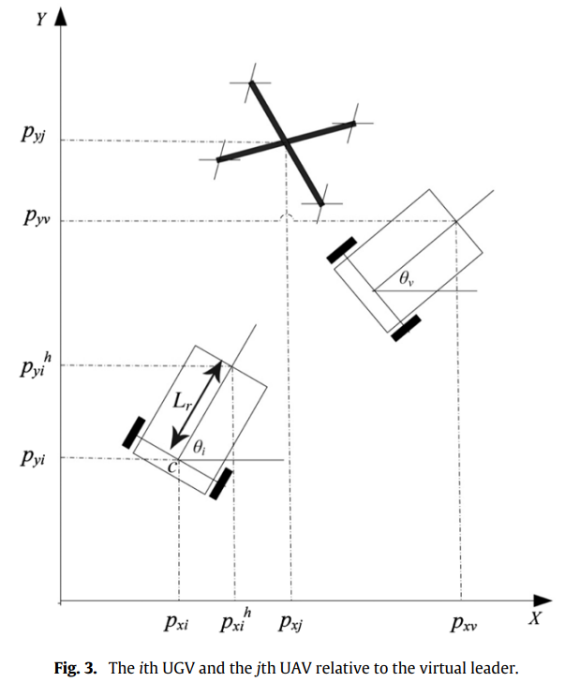
Model – Dynamics
Heterogeneous Formation
UGV - 2 wheeled cart-like robot
UAV – standard quadrotor

Slide 8
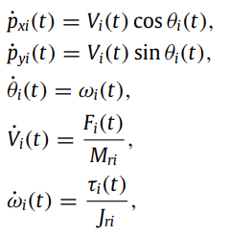

Model – UGV Dynamics
EOMs of the ith UGV
Notes:
Equations of motion describing velocity, angular velocity, acceleration and angular acceleration.
Control input for UGVs are force input and torque.

Slide 9
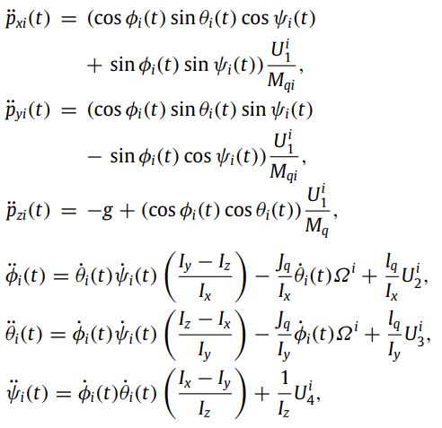


Model – UAV Dynamics
EOMs of the ith UAV
Notes:
Equations of motion describing acceleration and orientation.
Body inertias, mass, moment of inertia, length of rotor
Big omega is the sum of the rotor outputs
Control input for UGVs.

Slide 10

Model – Virtual Leader
VL is modeled as a UGV
Define formation with ith robot position relative to VL
Redefine position vector of ith robot in universal frame
Notes:
VL as a UGV since it has more limited movement

Slide 11

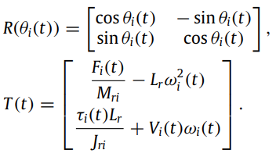
Model – VL-UGV Dynamics
Non-holonomic constraint:
Hand-point position:
Notes:
Non-holonomic constraint – Can’t define system with position alone. In this case, some orientation is needed to define system.

Slide 12


Model – VL-UGV Dynamics
Derivatives:
Using feedback linearization, new control input:
Notes:
Non-holonomic constraint – Can’t define system with position alone. In this case, some orientation is needed to define system.

Slide 13


Model – VL-UAV Dynamics
This is underactuated with 4 inputs and 6 DOF, but position is related to orientation (from EOM)
Desired position vector:
Use internal controller (stabilized with feedback linearization and IK) for orientation and external controller for positions

Slide 14




Back-stepping Synchronized Controller
Redefine the system with states and control signal
If f is a smooth function, goal is to design the feedback controller to stabilize the origin
2. Assume canonical form for the controller:

Slide 15



Back-stepping Synchronized Controller
With f(η) = 0 and g(η) = 1, we substitute and get:
Define the system with error instead of relative position/velocity:
Taking the derivatives:
Notes:
Same functional form, since desired eta-dot is 0 (rigid formation)

Slide 16
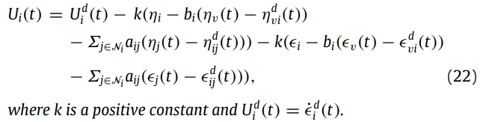
Theorem 4.1
The control signal (22) can stabilize a time-varying formation of MAS with the given dynamical model.
Notes:
Desired acceleration error (automatically 0)
Relative position of ith agent to virtual leader (defined, constant)
Relative position of ith agent to jth agent (defined, constant)
Relative velocity of ith agent to virtual leader (0)
Relative velocity of ith agent to jth agent (0)

Slide 17



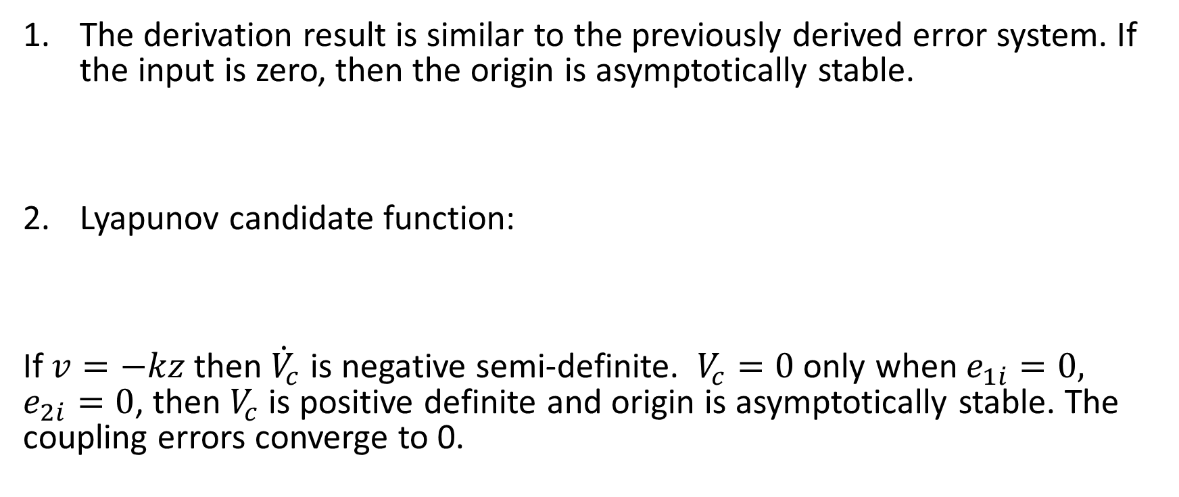
Theorem 4.1
The derivation result is similar to the previously derived error system. If the input is zero, then the origin is asymptotically stable.
Lyapunov candidate function:
If $v=−kz$ then ${\dot{V}}_{c}$ is negative semi-definite. $V_{c}=0$ only when $e_{1i}=0, e_{2i}=0$, then $V_{c}$ is positive definite and origin is asymptotically stable. The coupling errors converge to 0.
Notes:
Desired acceleration error (automatically 0)
Relative position of ith agent to virtual leader (defined, constant)
Relative position of ith agent to jth agent (defined, constant)
Relative velocity of ith agent to virtual leader (0)
Relative velocity of ith agent to jth agent (0)

Slide 18

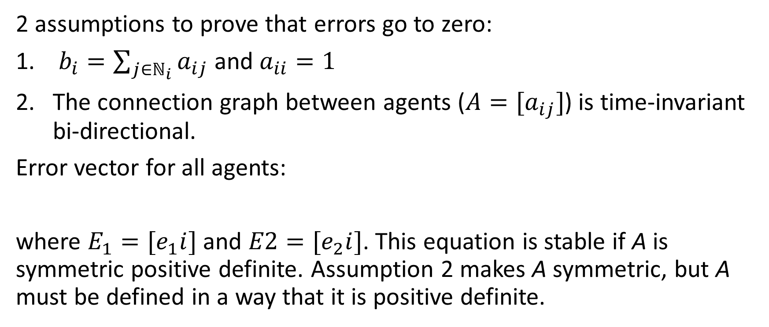
Theorem 4.1
2 assumptions to prove that errors go to zero:
$b_{i}=\sum_{j∈ℕ_{i}}{a_{ij}}$ and $a_{ii}=1$
The connection graph between agents ($A=[a_{ij}]$) is time-invariant bi-directional.
Error vector for all agents:
where $E_{1}=[e_{1}i]$ and $E2=[e_{2}i]$. This equation is stable if A is symmetric positive definite. Assumption 2 makes A symmetric, but A must be defined in a way that it is positive definite.
Notes:
Desired acceleration error (automatically 0)
Relative position of ith agent to virtual leader (defined, constant)
Relative position of ith agent to jth agent (defined, constant)
Relative velocity of ith agent to virtual leader (0)
Relative velocity of ith agent to jth agent (0)

Slide 19
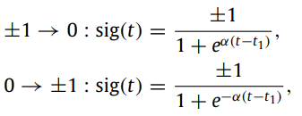
Simulation Results
Desired velocity of agents relative to the leader and neighbors is 0 (rigid formation)
Every agent receives the error of position and velocity of its neighbors. VL sends position and velocity to all agents.
Sigmoid function is used to smoothly transition to new formations.

Slide 20
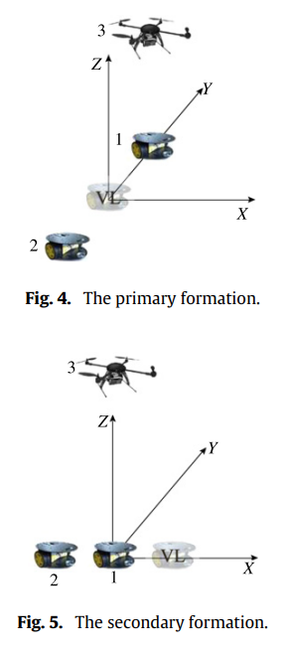
Simulation Results – Obstacle Avoidance
Primary formation is vertical stack on y axis. UAV hovers over UGV1.
Secondary formation is horizontal stack on x axis. UAV hovers over UGV1.
UAV starts on the ground and hovers at 1 m in primary formation and at 2 m in secondary formation.
Formation moves in some circular formation.

Slide 21
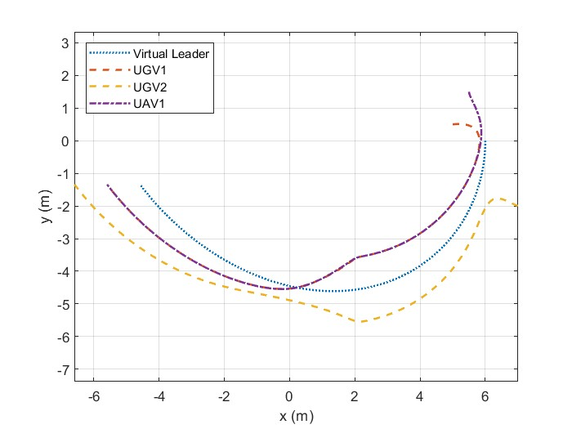
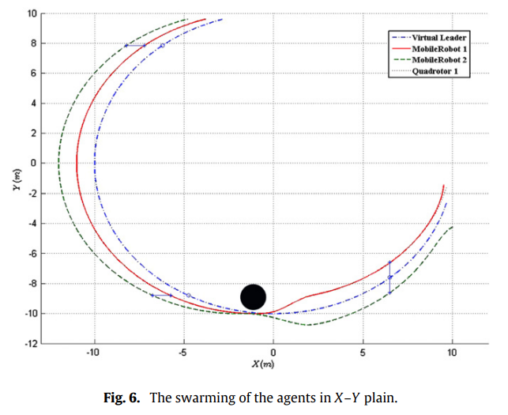
Simulation Results – Obstacle Avoidance

Slide 22
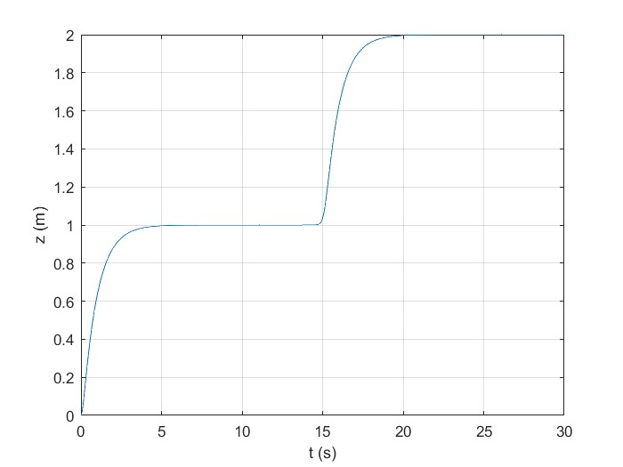
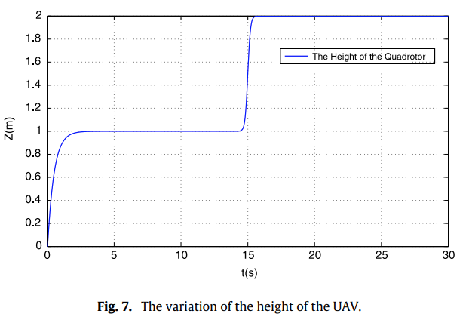
Simulation Results – Obstacle Avoidance

Slide 23
Simulation Results – Expand Coverage
Primary formation is square. UAV (5) hovers in the middle.
Secondary formation is square. UAV moves to the right.
Formation moves in some diagonal direction.

Slide 24
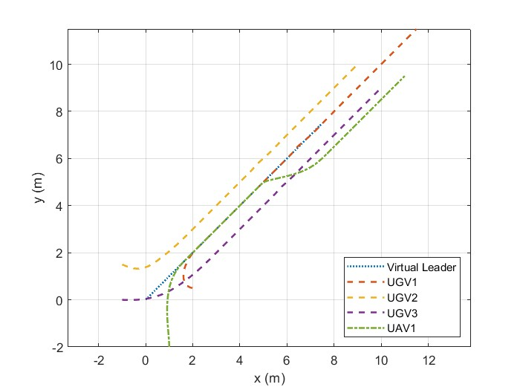
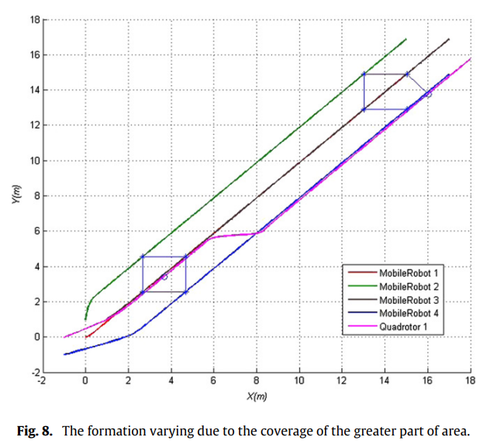
Simulation Results – Expand Coverage
Notes:
Discrepancy in secondary formation. My results show UGV1 and the virtual leader much farther ahead or behind, respectively, of the formation.
The paper doesn’t specify where the virtual leader is.

Slide 25
Summary
Solutions to obstacle avoidance and coverage are viable and successful
General formation control is successful, although agent-level control was not included
Only simple paths and formations were explored. Is it limited to these simple formations??

Slide 26
Future Work
Time-dependent formations (orbital formation)
Stabilization with agent failure
Limits of differing levels of connectedness

